Slide 1
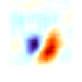
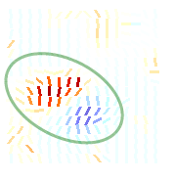
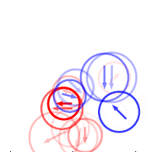
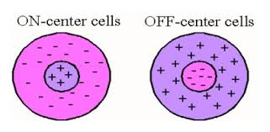
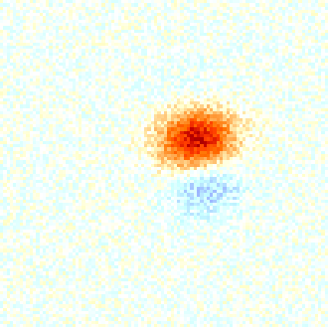
Visual Receptive Fields
Christopher Pack
Professor, Neurology & Neurosurgery
Montreal Neurological Institute
McGill University

Slide 2
Outline
Introduction to linear systems
Refinement of linear model and applications

Slide 3
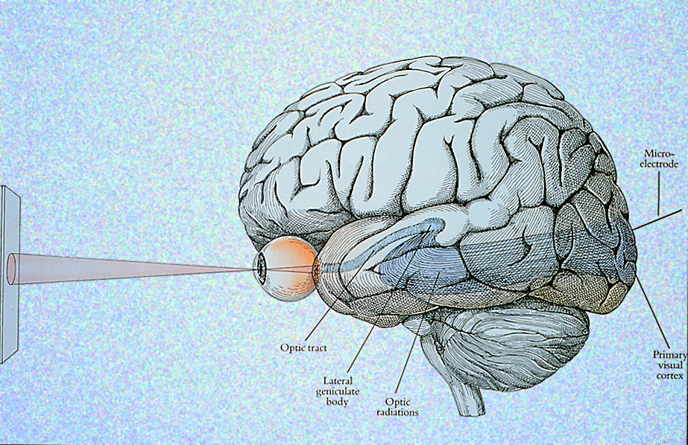

Central Visual Pathways

Slide 4

Action Potentials and Spike Trains
Two types of questions for modellers:
Encoding: If I know the stimulus can I predict the spike train?
Decoding: If I know the spike train, can I figure out what the stimulus was?
Notes:
What is a spike train?

Slide 5
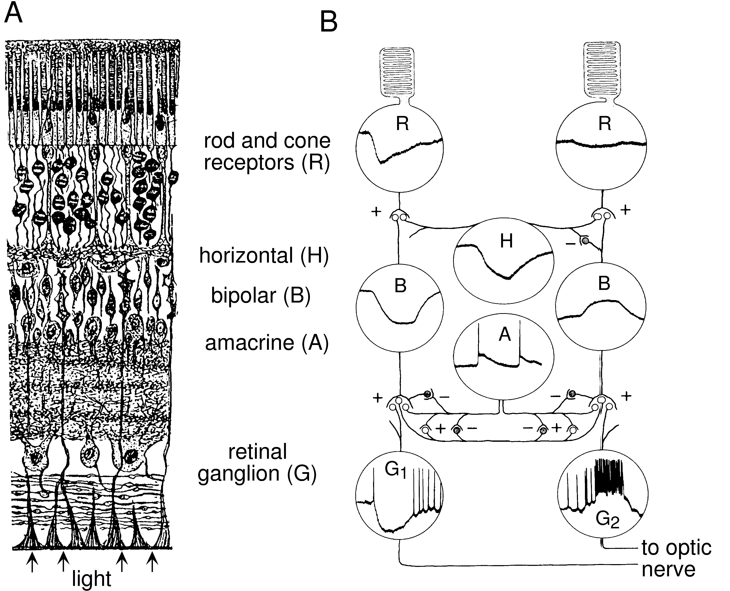
The Retina

Slide 6
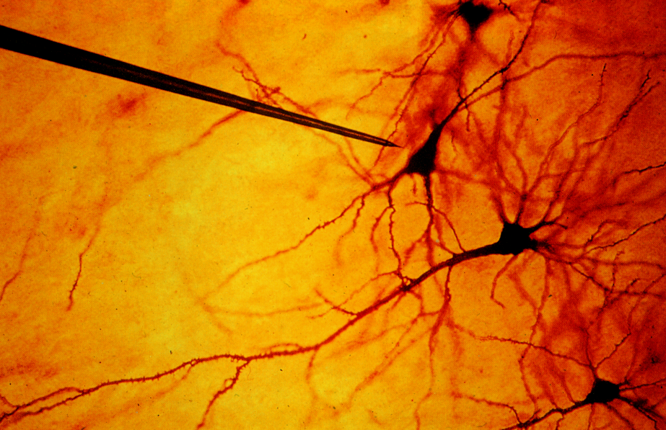
Extracellular microelectrode for recording neuronal action potentials

Slide 7
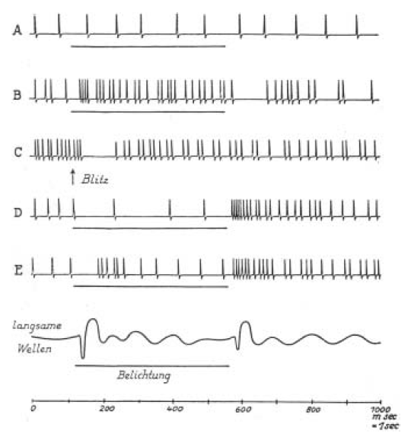
Baumgartner and Jung, 1955

Slide 8
The Retina
The retinal circuit is complicated, but it receives no feedback from the brain. One of its primary functions is to adapt to the statistics of the visual input. For example, vision is largely insensitive to the mean luminance in the input. The cortex operates largely on differences in luminance, so that we typically represent the output of the retina by:
where the average is taken over large extents of space and time.
As a result, the retina is not sensitive to light per se, but to patterns of light.

Slide 9
Receptive fields of retinal ganglion cells
Off-surround: The neuron responds to a small spot of light, if it is darker than the background.
On-center: The neuron responds to a small spot of light, if it is brighter than the background.
This is the receptive field of an on-center, off-surround retinal ganglion cell.

Slide 10
Receptive fields of retinal ganglion cells
On-surround: The neuron responds to a small spot of light, if it is lighter than the background.
Off-center: The neuron responds to a small spot of light, if it is darker than the background.
This is the receptive field of an off-center, on-surround retinal ganglion cell.

Slide 11

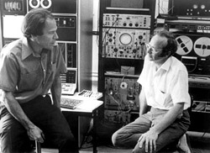
Wiesel
Hubel
Hubel/Wiesel movie #1

Slide 12
Retinal Ganglion Cells are the output of the retina
Action
potentials
ON-center, OFF-surround
r₀
+
S
t
i
m
u
l
u
s
:
o
n
o
f
f
Kuffler 1953

Slide 13
Action Potentials and Spike Trains
Two types of questions for modellers:
Encoding: If I know the stimulus can I predict the spike train?
Decoding: If I know the spike train, can I figure out what the stimulus was?
s(x,y,t)
r(t)

Slide 14
Receptive field as spatial filter
0 0 0 0 0 0 0 0 0 0 0 0 0 0 0 0 0 0 0
0 0 0 0 0 0 0 -1 -1 -1 0 0 0 0 0 0 0 0
0 0 0 0 0 0 -1 -1 -1 -1 -1 0 0 0 0 0 0
0 0 0 0 -1 -1 -1 -1 -1 -1 -1 -1 0 0 0 0
0 0 0 0 -1 -1 -1 +1 +1 -1 -1 -1 0 0 0
0 0 0 0 -1 -1 +1 +1 +1 +1 -1 -1 0 0 0
0 0 0 0 -1 -1 +1 +1 +1 +1 -1 -1 0 0 0
0 0 0 0 -1 -1 -1 +1 +1 -1 -1 -1 0 0 0
0 0 0 0 0 0 -1 -1 -1 -1 -1 -1 0 0 0 0 0
0 0 0 0 0 0 0 -1 -1 -1 -1 0 0 0 0 0 0 0
0 0 0 0 0 0 0 0 0 0 0 0 0 0 0 0 0 0 0
Let’s call this h(x,y). The neuron responds when the stimulus matches its receptive field. Or more precisely, the neuron computes the degree of correlation between the stimulus and the receptive field.

Slide 15


Slide 16

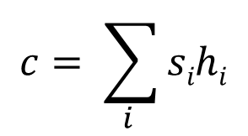
Correlation
0 0 0 0 0 0 0 0 0 0 0 0 0 0 0 0 0 0 0
0 0 0 0 0 0 0 -1 -1 -1 0 0 0 0 0 0 0 0
0 0 0 0 0 0 -1 -1 -1 -1 -1 0 0 0 0 0 0
0 0 0 0 -1 -1 -1 -1 -1 -1 -1 -1 0 0 0 0
0 0 0 0 -1 -1 -1 +1 +1 -1 -1 -1 0 0 0
0 0 0 0 -1 -1 +1 +1 +1 +1 -1 -1 0 0 0
0 0 0 0 -1 -1 +1 +1 +1 +1 -1 -1 0 0 0
0 0 0 0 -1 -1 -1 +1 +1 -1 -1 -1 0 0 0
0 0 0 0 0 0 -1 -1 -1 -1 -1 -1 0 0 0 0 0
0 0 0 0 0 0 0 -1 -1 -1 -1 0 0 0 0 0 0 0
0 0 0 0 0 0 0 0 0 0 0 0 0 0 0 0 0 0 0
$$c= \sum_{i }{sihi}$$

Slide 17
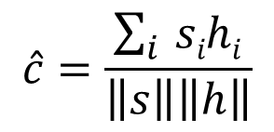
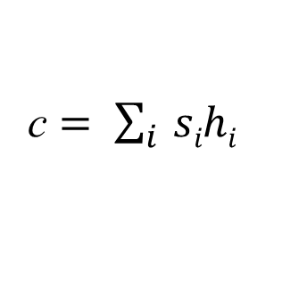
Normalization
0 0 0 0 0 0 0 0 0 0 0 0 0 0 0 0 0 0 0
0 0 0 0 0 0 0 -1 -1 -1 0 0 0 0 0 0 0 0
0 0 0 0 0 0 -1 -1 -1 -1 -1 0 0 0 0 0 0
0 0 0 0 -1 -1 -1 -1 -1 -1 -1 -1 0 0 0 0
0 0 0 0 -1 -1 -1 +1 +1 -1 -1 -1 0 0 0
0 0 0 0 -1 -1 +1 +1 +1 +1 -1 -1 0 0 0
0 0 0 0 -1 -1 +1 +1 +1 +1 -1 -1 0 0 0
0 0 0 0 -1 -1 -1 +1 +1 -1 -1 -1 0 0 0
0 0 0 0 0 0 -1 -1 -1 -1 -1 -1 0 0 0 0 0
0 0 0 0 0 0 0 -1 -1 -1 -1 0 0 0 0 0 0 0
0 0 0 0 0 0 0 0 0 0 0 0 0 0 0 0 0 0 0
c $= \sum_{i }{sihi}$
(raw correlation)
$$\hat{c}=\frac{\sum_{i }{sihi}}{\left\|s\right\|\left\|h\right\|}$$
(normalized correlation)

Slide 18
Receptive field as temporal filter
Action
potentials
ON-center, OFF-surround
r₀
+
S
t
i
m
u
l
u
s
:
o
n
o
f
f
r
t
Notice that the response is delayed and that it lasts longer than the stimulus, which is very brief. We call this the impulse response.

Slide 19
Receptive fields in space and time
0 0 0 0 0 0 0 0 0 0 0 0 0 0 0 0 0 0 0
0 0 0 0 0 0 0 -1 -1 -1 0 0 0 0 0 0 0 0
0 0 0 0 0 0 -1 -1 -1 -1 -1 0 0 0 0 0 0
0 0 0 0 -1 -1 -1 -1 -1 -1 -1 -1 0 0 0 0
0 0 0 0 -1 -1 -1 +1 +1 -1 -1 -1 0 0 0
0 0 0 0 -1 -1 +1 +1 +1 +1 -1 -1 0 0 0
0 0 0 0 -1 -1 +1 +1 +1 +1 -1 -1 0 0 0
0 0 0 0 -1 -1 -1 +1 +1 -1 -1 -1 0 0 0
0 0 0 0 0 0 -1 -1 -1 -1 -1 -1 0 0 0 0 0
0 0 0 0 0 0 0 -1 -1 -1 -1 0 0 0 0 0 0 0
0 0 0 0 0 0 0 0 0 0 0 0 0 0 0 0 0 0 0
r
t
So the receptive field is really two things: A spatial filter and an impulse response. For simplicity, we treat these as separable, meaning that we can study the spatial and temporal parts independently. A separable model has the form h(x,y)*h(t).

Slide 20

r
r
r
t
t
t
We’ll consider the temporal part first…

Slide 21
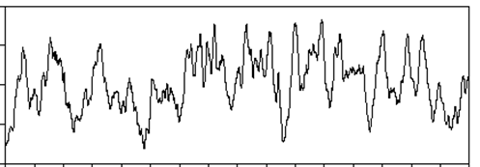
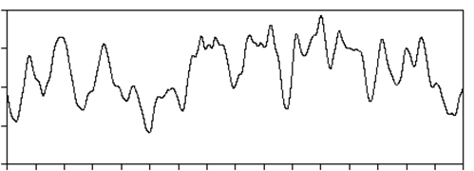
s(t)
r(t)
Time ->
Again notice:
The neuron (obviously) responds to stimuli that occurred in the past (i.e. there is a delay).
The neural response changes more slowly than the stimulus. This is due to the sluggish impulse response we saw before.

Slide 22
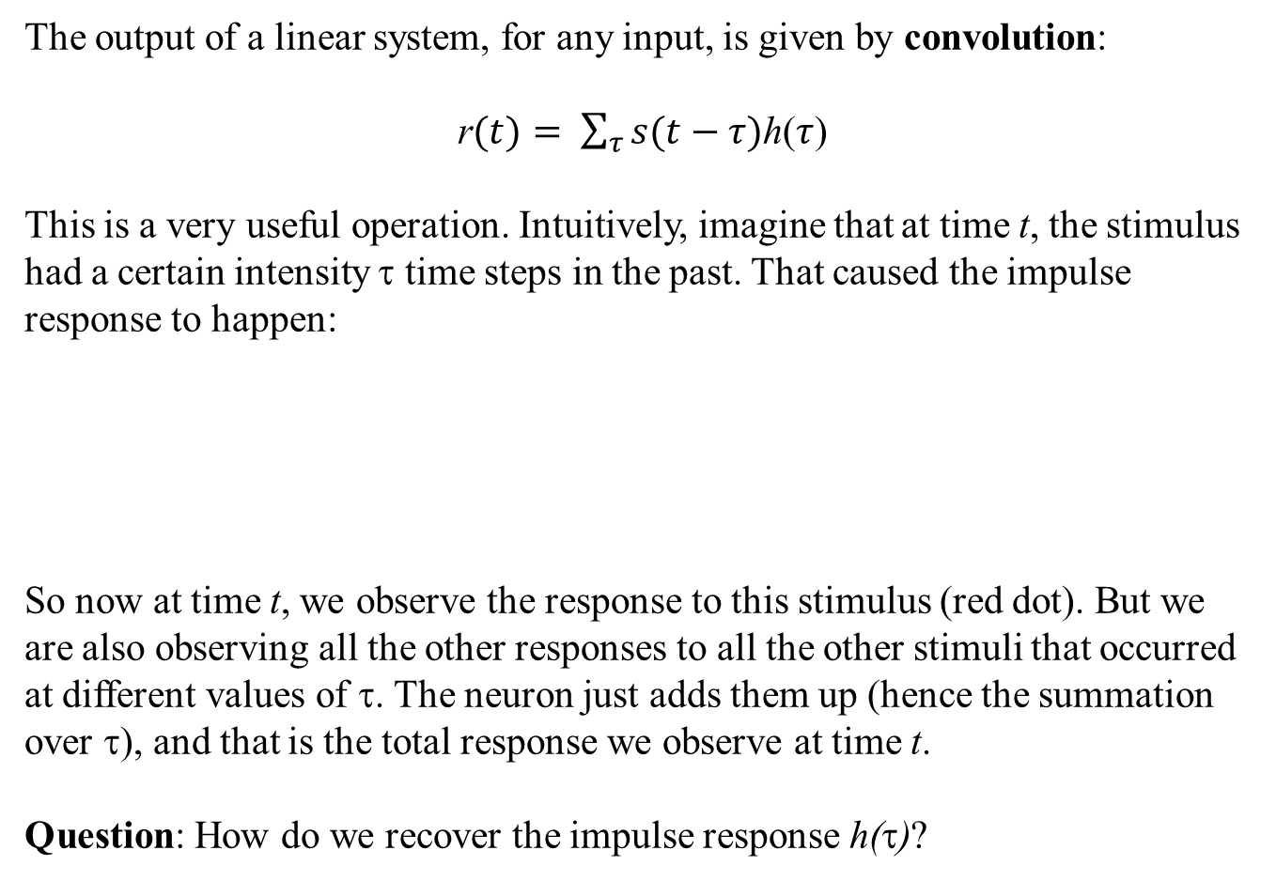
Linear systems
The output of a linear system, for any input, is given by convolution:
r$(t)= \sum_{τ}{s(t−τ)}$h($τ$)
This is a very useful operation. Intuitively, imagine that at time t, the stimulus had a certain intensity τ time steps in the past. That caused the impulse response to happen:
So now at time t, we observe the response to this stimulus (red dot). But we are also observing all the other responses to all the other stimuli that occurred at different values of τ. The neuron just adds them up (hence the summation over τ), and that is the total response we observe at time t.
Question: How do we recover the impulse response h(τ)?
r
t – τ t

Slide 23
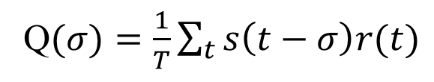
Cross-correlation
s(t)
r(t)
Time ->
Q$(σ)=\frac{1}{T}\sum_{t}{s\left(t−σ\right)r(t)}$

Slide 24
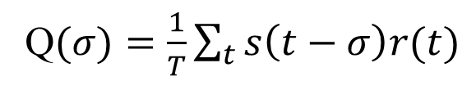
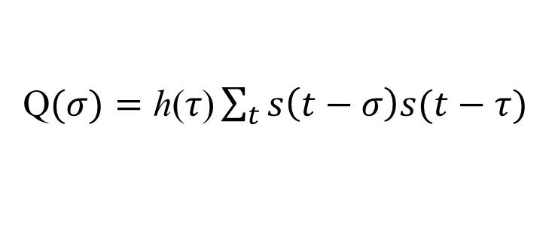
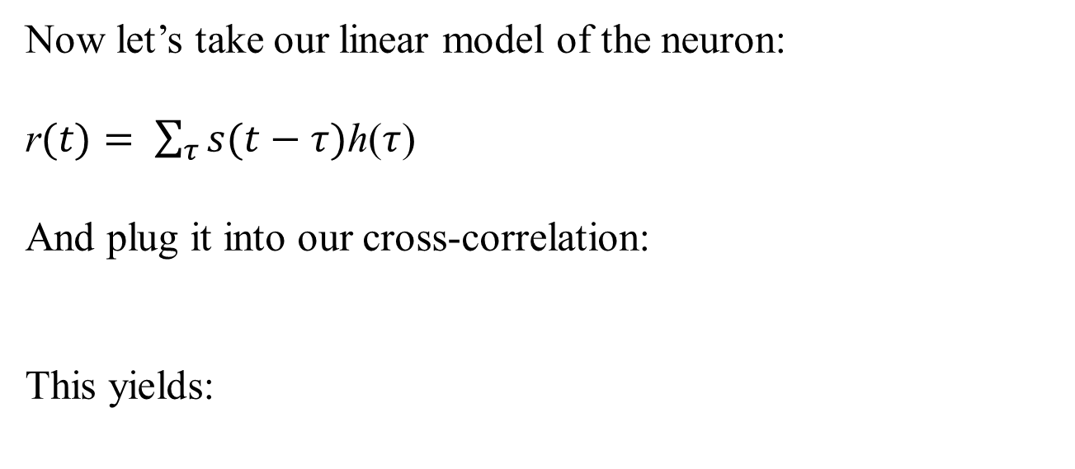
Now let’s take our linear model of the neuron:
r$(t)= \sum_{τ}{s(t−τ)}$h($τ$)
And plug it into our cross-correlation:
This yields:
Q$(σ)=\frac{1}{T}\sum_{t}{s\left(t−σ\right)r(t)}$
Q$(σ)=\text{h}\text{(}τ\text{)}\sum_{t}{s\left(t−σ\right)s(t−τ)}$

Slide 25
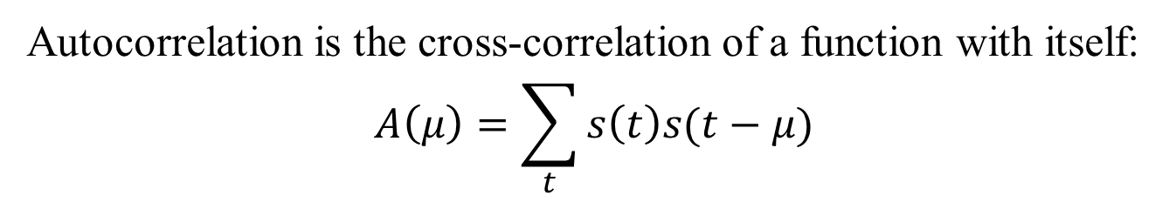
Autocorrelation
Autocorrelation is the cross-correlation of a function with itself:
$$A\left(μ\right)=\sum_{t}{s\left(t\right)s(t−μ)}$$

Slide 26
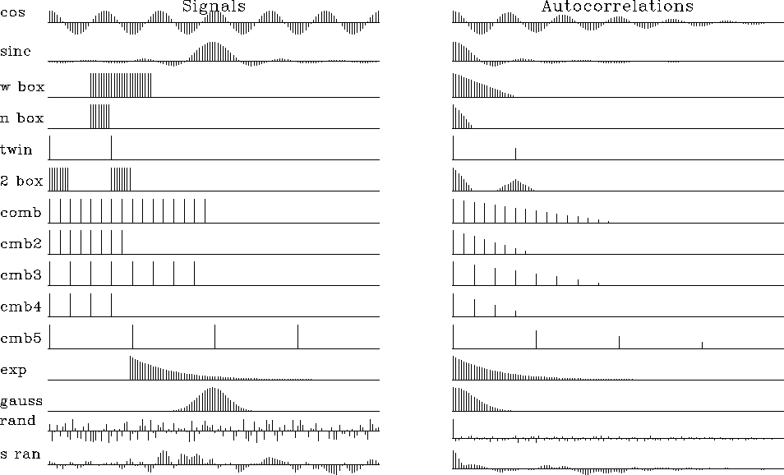
Autocorrelation

Slide 27

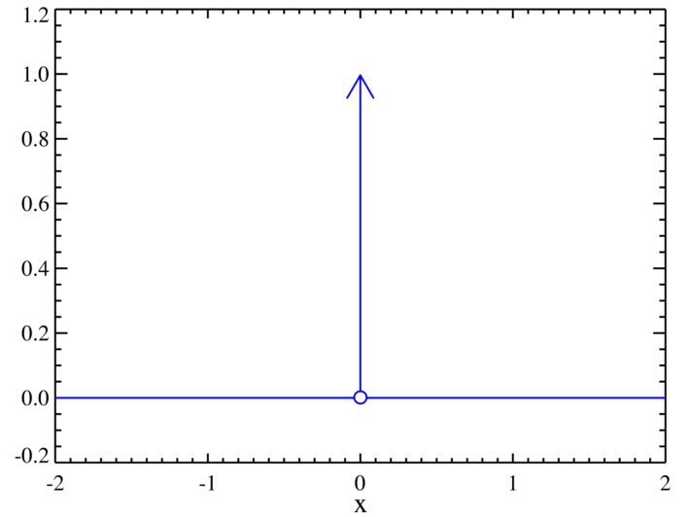
Dirac Delta Function
The Delta function takes a constant value at τ = 0 and is 0 everywhere else:
τ
The autocorrelation of a random sequence is a delta function.

Slide 28
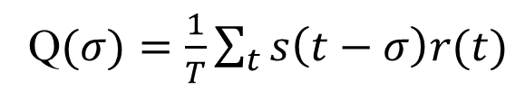
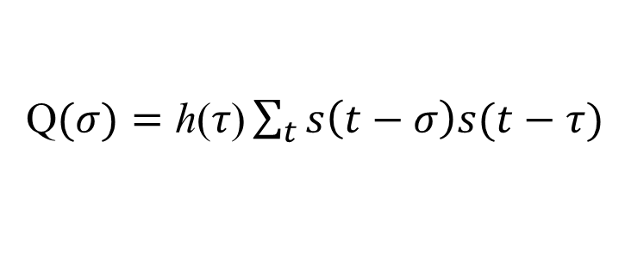
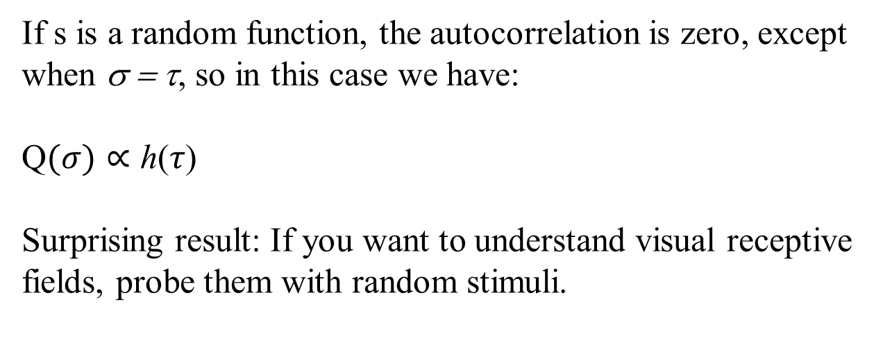
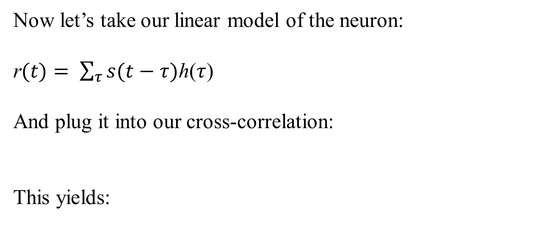
Now let’s take our linear model of the neuron:
r$(t)= \sum_{τ}{s(t−τ)}$h($τ$)
And plug it into our cross-correlation:
This yields:
Q$(σ)=\frac{1}{T}\sum_{t}{s\left(t−σ\right)r(t)}$
Q$(σ)=\text{h}\text{(}τ\text{)}\sum_{t}{s\left(t−σ\right)s(t−τ)}$
If s is a random function, the autocorrelation is zero, except when σ = τ, so in this case we have:
Q$(σ)∝\text{h}\text{(}τ\text{)}$
Surprising result: If you want to understand visual receptive fields, probe them with random stimuli.

Slide 29
In practice, one can estimate the receptive field position crudely and then probe it more precisely at a spot:
t
According to the assumptions we have made (linearity, separability), this will be sufficient to recover the temporal impulse response.

Slide 30
Summary and conclusions
We can model receptive fields by assuming that the spatial and temporal responses are separable and linear.
In that case, we can study them by using stimuli that are random.
If the stimulus is random, then the temporal response is just the (normalized) cross-correlation between the input and the output.
From there, the spatial part is easy…

Slide 31
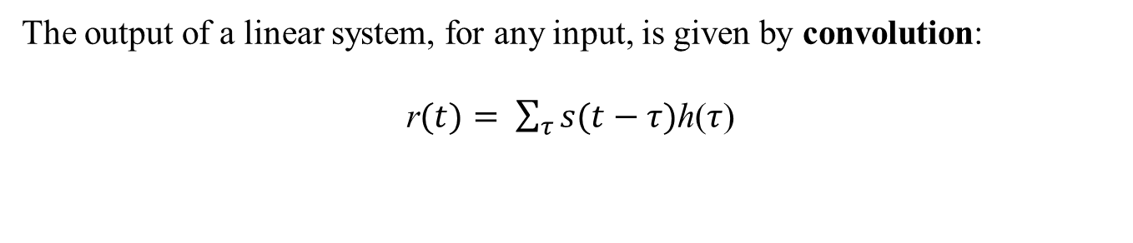
Linear systems
The output of a linear system, for any input, is given by convolution:
r$(t)= \sum_{τ}{s(t−τ)}$h($τ$)
0 0 0 0 0 0 0 0 0 0 0 0 0 0 0 0 0 0 0
0 0 0 0 0 0 0 -1 -1 -1 0 0 0 0 0 0 0 0
0 0 0 0 0 0 -1 -1 -1 -1 -1 0 0 0 0 0 0
0 0 0 0 -1 -1 -1 -1 -1 -1 -1 -1 0 0 0 0
0 0 0 0 -1 -1 -1 +1 +1 -1 -1 -1 0 0 0
0 0 0 0 -1 -1 +1 +1 +1 +1 -1 -1 0 0 0
0 0 0 0 -1 -1 +1 +1 +1 +1 -1 -1 0 0 0
0 0 0 0 -1 -1 -1 +1 +1 -1 -1 -1 0 0 0
0 0 0 0 0 0 -1 -1 -1 -1 -1 -1 0 0 0 0 0
0 0 0 0 0 0 0 -1 -1 -1 -1 0 0 0 0 0 0 0
0 0 0 0 0 0 0 0 0 0 0 0 0 0 0 0 0 0 0

Slide 32
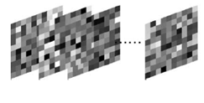
From the linearity assumption, we can treat the receptive field as a collection of points, each of which elicits a temporal impulse response when stimulated:
0 0 0 0 0 0 0 0 0 0 0 0 0 0 0 0 0 0 0
0 0 0 0 0 0 0 -1 -1 -1 0 0 0 0 0 0 0 0
0 0 0 0 0 0 -1 -1 -1 -1 -1 0 0 0 0 0 0
0 0 0 0 -1 -1 -1 -1 -1 -1 -1 -1 0 0 0 0
0 0 0 0 -1 -1 -1 +1 +1 -1 -1 -1 0 0 0
0 0 0 0 -1 -1 +1 +1 +1 +1 -1 -1 0 0 0
0 0 0 0 -1 -1 +1 +1 +1 +1 -1 -1 0 0 0
0 0 0 0 -1 -1 -1 +1 +1 -1 -1 -1 0 0 0
0 0 0 0 0 0 -1 -1 -1 -1 -1 -1 0 0 0 0 0
0 0 0 0 0 0 0 -1 -1 -1 -1 0 0 0 0 0 0 0
0 0 0 0 0 0 0 0 0 0 0 0 0 0 0 0 0 0 0
Because they are independent, we can stimulate all the points at once:
If the stimuli are all random and uncorrelated with each other, we can still recover the spatial and temporal receptive field using cross-correlation. More on this later..

Slide 33
Central Visual Pathways

Slide 34
Neurons in the Visual Pathway
Extrastriate Cortex
Rest of
Cortex
10⁹
V1
Number of Cells
10⁷
retina
LGN
10⁵
Barlow, 1980
The number of neurons increases by a factor of ~200 from the retina/LGN to the visual cortex.
About 50% of all cortical neurons are involved in vision.
Notes:
What is the difference between cortex and retina/LGN and brain?

Slide 35
Neuronal responses in the LGN
Light
Light
LGN responses do not depend on the orientation of a bar.
0
1
2
3 sec

Slide 36
Neuronal responses in V1
Light
Light
V1 responses depend on bar orientation
When probed with a small spot, a V1 cell
behaves somewhat like an LGN cell.
0
1
2
3 sec

Slide 37
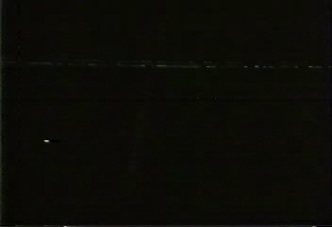
Orientation selectivity in V1 simple cells
Wiesel
Hubel
Hubel/Wiesel movie #2

Slide 38
A Simple Cell Model
3
2
LGN:
1
V1
Hubel & Wiesel 1962

Slide 39
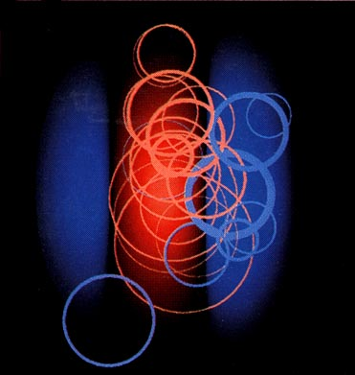
A Simple Cell Model Confirmed
Alonso & Reid, 1995

Slide 40
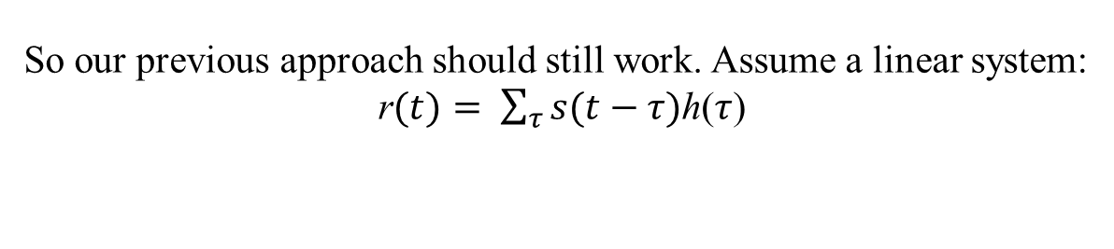
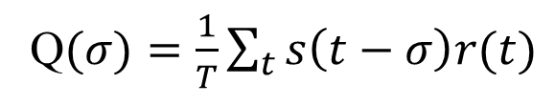
Linear systems
Neurons integrate inputs from other neurons and generate a response. A key assumption of the H/W model of simple cells is that the inputs are (roughly) linearly related to the stimulus.
C
B
A
Hubel & Wiesel 1962
So our previous approach should still work. Assume a linear system:
r$(t)= \sum_{τ}{s(t−τ)}$h($τ$)
And we should still be able to recover the temporal filter by cross-correlation:
Q$(σ)=\frac{1}{T}\sum_{t}{s\left(t−σ\right)r(t)}$
This leads to a very simple trick for recovering the full space-time receptive field…

Slide 41
Action Potentials and Spike Trains
Two types of questions for modellers:
Encoding: If I know the stimulus can I predict the spike train?
Decoding: If I know the spike train, can I figure out what the stimulus was?

Slide 42
Dirac Delta Function
The Delta function takes a constant value at τ = 0 and is 0 everywhere else:
τ
The autocorrelation of a random sequence is a delta function.

Slide 43
Spike-triggered averaging
For spike trains, the neuronal output is (roughly) 1 or 0 at any given moment, so we can write the response r as a sum of delta functions:
where t_{i} is the time of the i^{th} spike. That is,
r(t) =
+
+
+
+
=

Slide 44
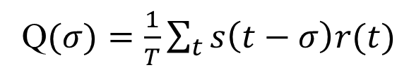
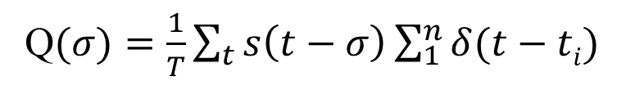
Spike-triggered averaging
Recall that:
Q$(σ)=\frac{1}{T}\sum_{t}{s\left(t−σ\right)r(t)}$
This can be rewritten:
Q$(σ)=\frac{1}{T}\sum_{t}{s\left(t−σ\right)\sum_{1}^{n}{δ(t−ti)}}$
which only has a value when t = t_{i}, so that:
In other words, the neuron’s temporal response is just the average stimulus that preceded each spike by σ ms. This approach is called spike-triggered averaging or reverse correlation.

Slide 45
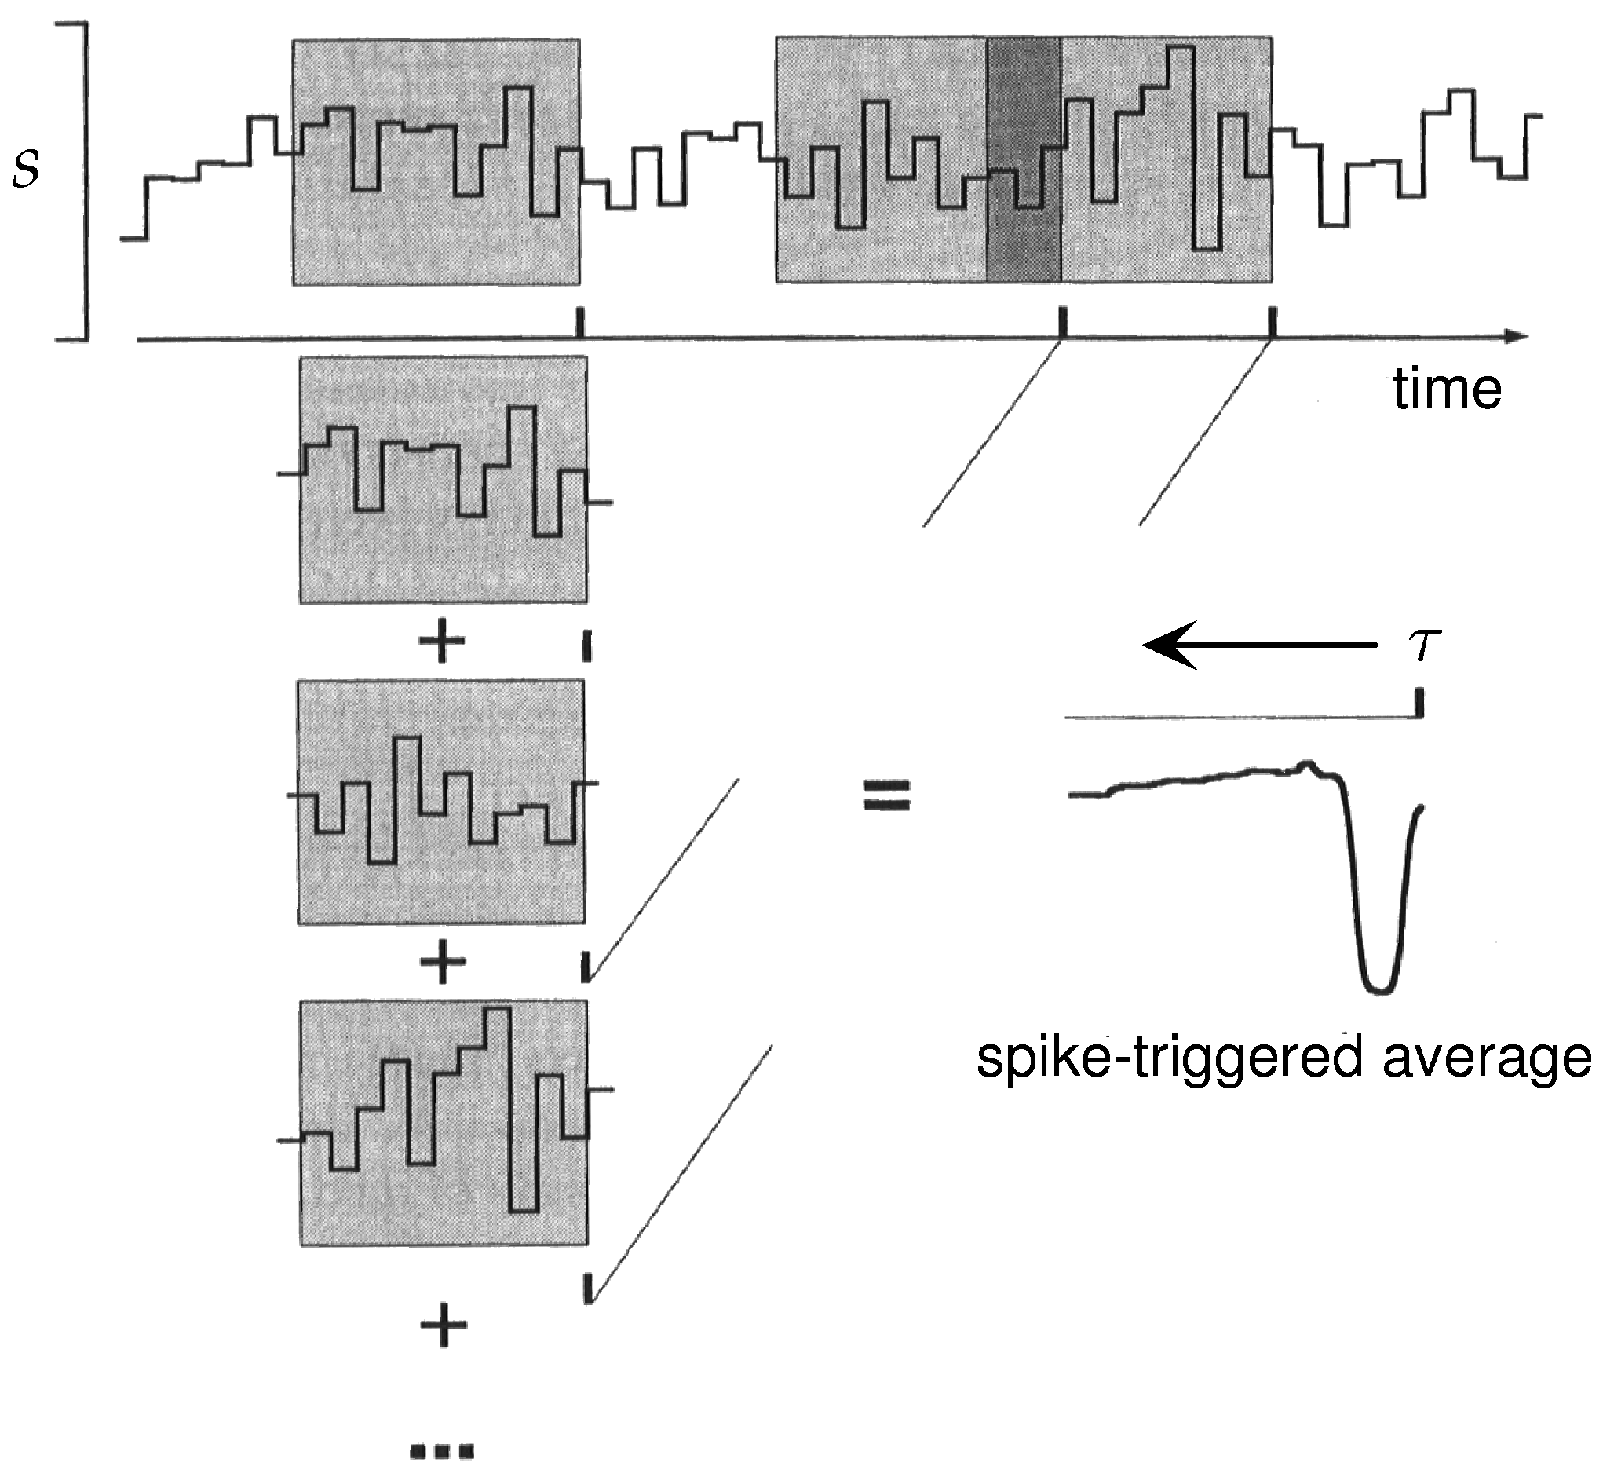
Example of Spike-triggered averaging

Slide 46
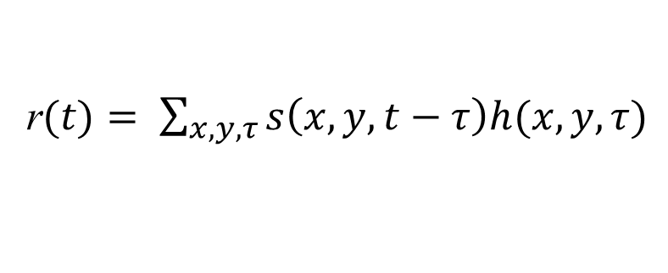
Linear filtering approach: Application to V1 simple cells
For a one-dimensional input, the output of our linear filter was:
But simple cells respond to (at least) three input dimensions: two for space and one for time. So we need to include them in the equation:
r$(t)= \sum_{x,y,τ}{s\left(x,y,t−τ\right)h(x,y,τ)}$
Note that the output depends only on time, so we need to integrate over the spatial dimensions.

Slide 47

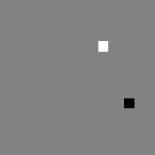


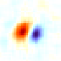
Application: V1 simple cell
Spike train
τ
τ
Stimulus
V1 Map
1
+
+
y
+
y
-
+
=
0
-
y (deg.)
0
+
-1
-
x
x
-1
0
1
x (deg.)
The spatial receptive field at a single value of τ can be measured with spike-triggered averaging.

Slide 48

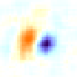


Application: V1 simple cell
τ = 85
τ = 75
τ = 65
τ = 55
τ = 45
h_{s}(x,y)
4
3
Σ|L(x,y)|
h_{t}(τ)
2
1
0
-120
-80
-40
0
Time (ms)
The temporal receptive field can be measured by computing the spatial receptive field at different values of τ.

Slide 49
Outline
Introduction to linear systems
Refinement of linear model and applications

Slide 50
Spike-triggered averaging
Assumptions behind spike-triggered averaging:
Spikes depend on the stimulus, rather than attention, anesthetic levels, other spikes, etc.
The stimulus autocorrelation is flat, which usually means that the stimulus is white noise.
The cell’s response is linear!
Assumption #3 can be tested by plugging our estimate of h(τ) into:
If the cell is linear, then we should be able to predict the real response R based on our knowledge of h and s.

Slide 51
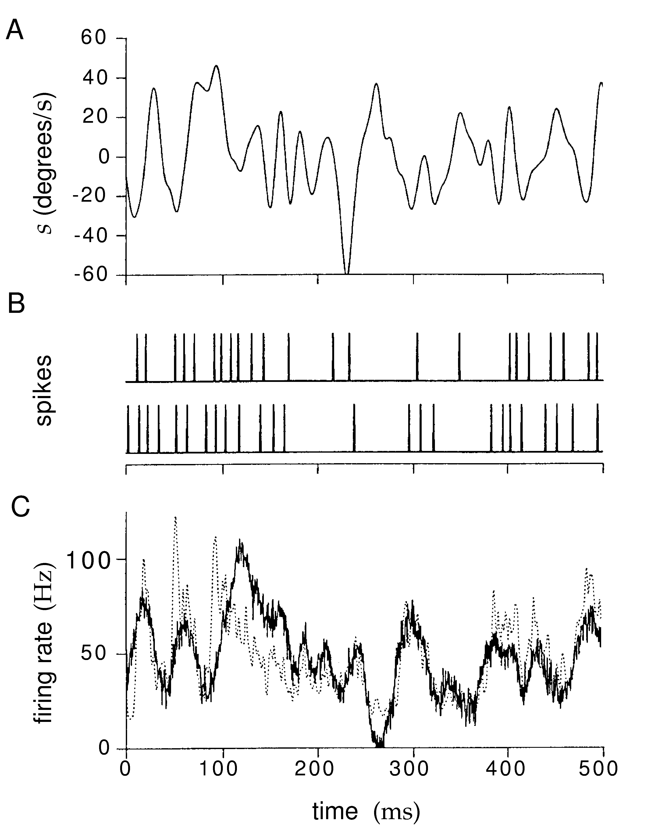
Spike-triggered averaging
Predicted
Measured

Slide 52
Spike-triggered averaging
Spike-triggered averaging (or any linear method) will fail if the neuron:
Is affected by something other than the stimulus
Has a response that is very nonlinear in its inputs
Has a static nonlinearity that affects firing rate
Example: The firing rate cannot be negative.
Example: The firing rate cannot be infinite.

Slide 53
Static Nonlinearities
Recall the linear response:
If the cell’s response includes a static nonlinearity, we can model it as:
where F can in principle be any function. In practice it will have the properties of real neurons: nonnegativity, saturation, and a few others.

Slide 54
Static Nonlinearities
L₀
To set a firing threshold at L₀:
F
This function cannot be negative.
R_{est}(t)
A sigmoid function has a threshold, and it saturates for large inputs:
r_{max}
F
L_{1/2}
R_{est}(t)

Slide 55
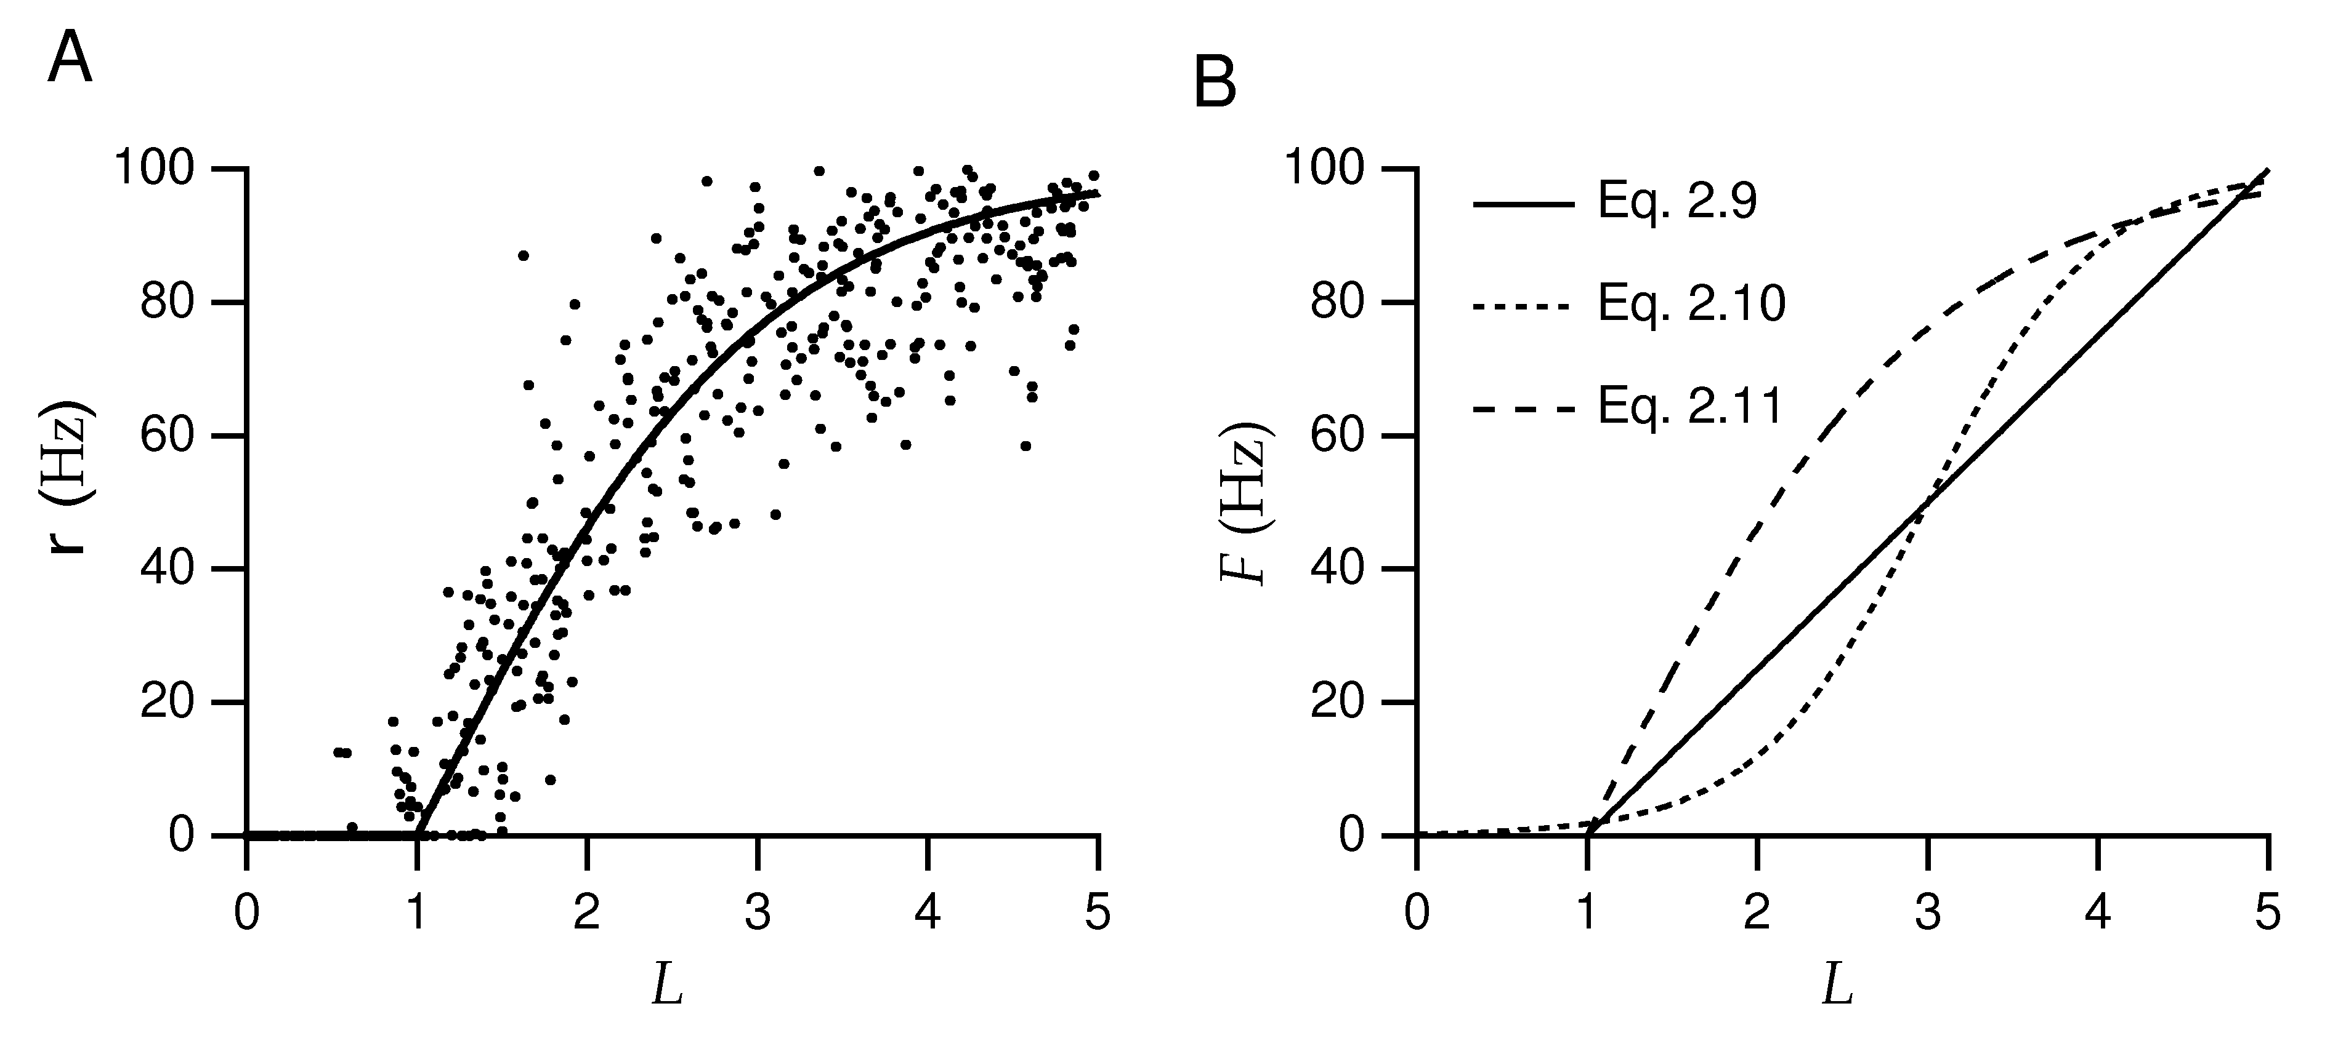
Static Nonlinearities
measured
predicted
If the linear model were sufficient, the relationship between predicted and measured response would be a straight line. In practice there is usually a nonlinear relationship.

Slide 56
Static Nonlinearities
Static nonlinearities:
Depend only on the response at an instant in time.
Do not depend directly on the stimulus. This is important because other nonlinearities require a large amount of data to compute.
Typically have a threshold and a saturation point

Slide 57
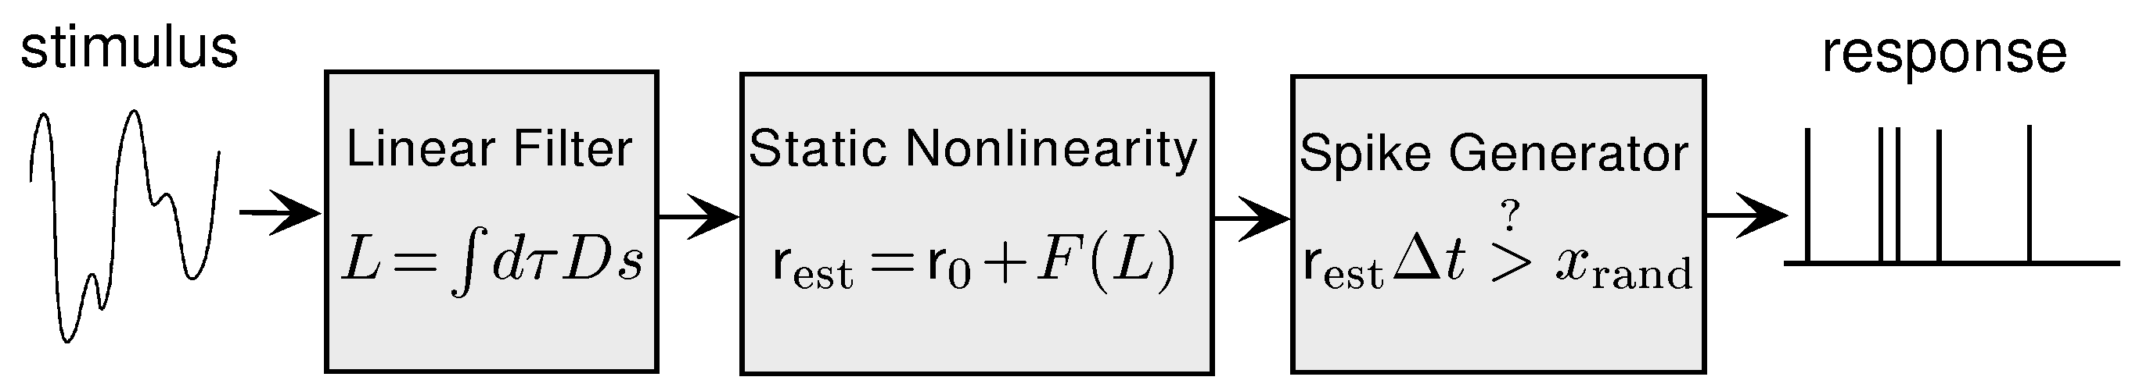
Linear filtering approach: Summary
The neuron’s response is modeled as a linear filter that operates on the stimulus, a static nonlinearity that operates on the output of the filter, and a spike generating mechanism that operates on the output of the nonlinearity.

Slide 58
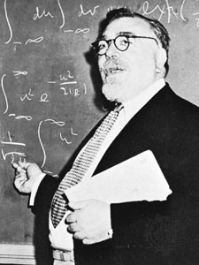
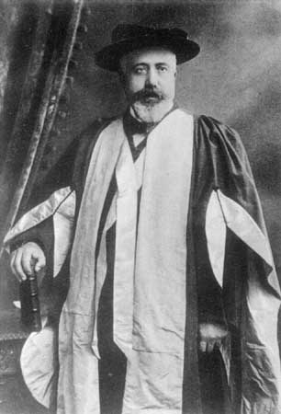
The Weiner/Volterra Approach
Key idea: describe the response of the system in terms of the statistics of the input:
Zeroth-order: r0
First-order:
Second-order:
Complete:
where s is the stimulus and D_{n} is the n^{th} kernel.
If we could find the D_{n}’s, we would know everything about the system!

Slide 59
Summary
Brief overview of the visual system
Visual system is complicated, but some neurons in the primary visual cortex have receptive fields that are somewhat linear.
Introduction to linear systems
The output of a linear system is given by the convolution of its input with a kernel, which for a visual neuron is the receptive field in space and time. The kernel can be recovered by cross-correlating the output and input, provided that the input is random.
Some intuitions
Convolution: The neuron’s response at some point in time reflects the sum of the responses to individual stimuli at different time points in the immediate past.
Cross-correlation: When the stimulus value increases, the neuron’s response should increase (or decrease for an OFF region) a bit later.
Auto-correlation: The correlation between the stimulus and the response is hard to interpret if there is a correlation between the stimulus and the stimulus.
Spike-triggered averaging: Since the response at each time point is a spike, we can relate it to a snapshot of the stimulus some time earlier.
Refinement of linear model and applications
Linear models fail to capture simple aspects of neuronal responses, such as thresholds and saturation. These can be incorporated as static nonlinearities. Other nonlinear processing requires more complex models.

Slide 60
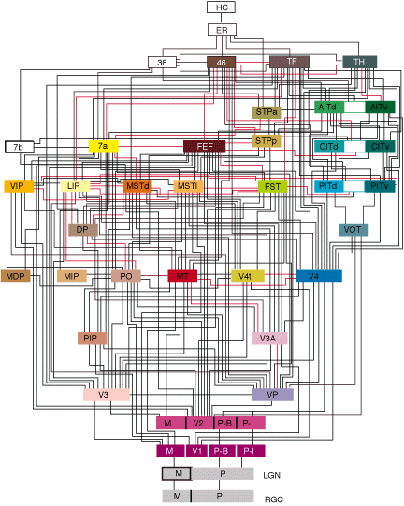
Felleman and Van Essen, 1991

Slide 61
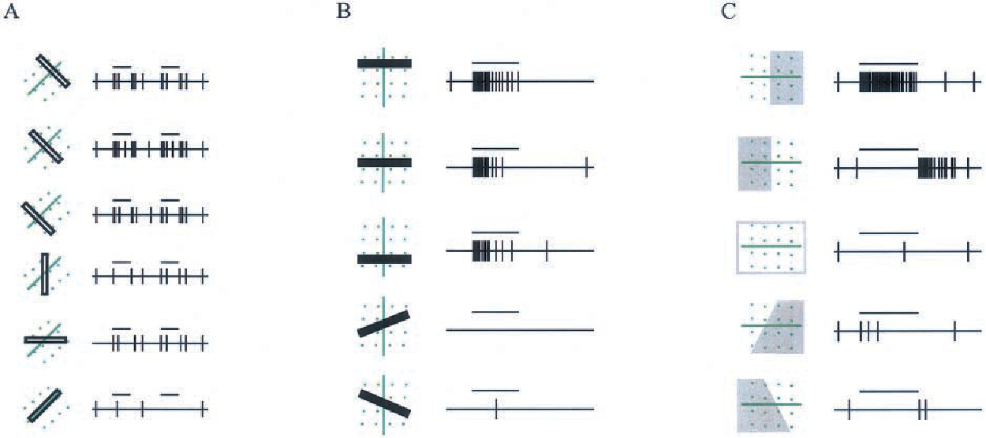
Complex cells in V1
Hubel & Wiesel, 1962
Martinez & Alonso, 2003

Slide 62
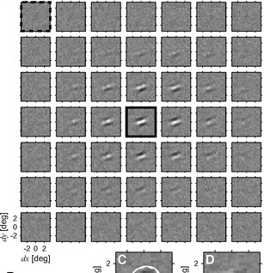
Spatial convolution in V1 complex cells
Complex cell receptive field
V1 complex cells are approximated by spatial convolution with a subunit that looks like a simple cell receptive field.
Sasaki & Ohzawa, 2007

Slide 63
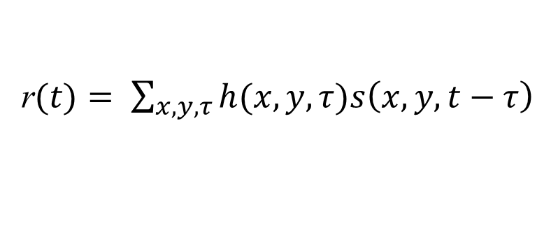
Linear filtering approach: Application to V1 simple cells
For a one-dimensional input, the output of our linear filter was:
But simple cells respond to (at least) three input dimensions: two for space and one for time. So we need to include them in the equation:
r$(t)= \sum_{x,y,τ}{h(x,y,τ)s\left(x,y,t−τ\right)}$
Note that the output depends only on time, so we need to integrate over the spatial dimensions.
This model implements convolution in time, but not in space.

Slide 64
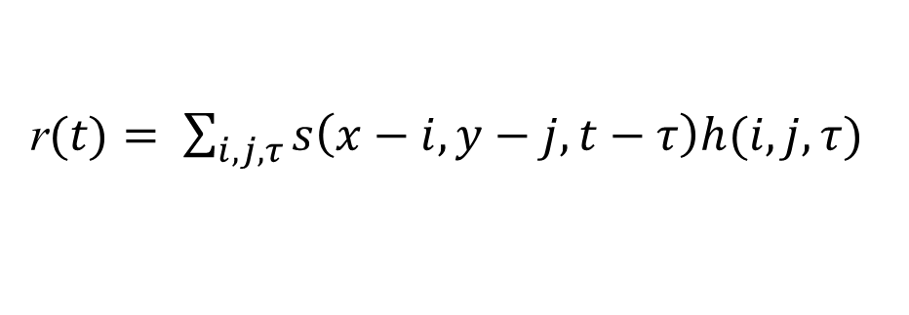
Convolution in space and time
r$(t)= \sum_{i,j,τ}{s\left(x−i,y−j,t−τ\right)h(i,j,τ)}$
This model has convolution in space and time.
Vintch et al., 2015

Slide 65
Spatial convolution in V1 complex cells
Complex cell receptive field
V1 complex cells are approximated by spatial convolution with a subunit that looks like a simple cell receptive field.
Sasaki & Ohzawa, 2007

Slide 66
Convolution in space and time
r$(t)= \sum_{i,j,τ}{s\left(x−i,y−j,t−τ\right)h(i,j,τ)}$
r$(t)=\sum{w\left(x,y\right)f_{s}}\left[\sum_{i,j,τ}{s\left(x−i,y−j,t−τ\right)h(i,j,τ)}\right]$
This model has space-time convolution, plus spatial weighting.
Vintch et al., 2015

Slide 67
Spatial convolution in V1 complex cells
Complex cell receptive field
V1 complex cells are approximated by spatial convolution with a subunit that looks like a simple cell receptive field.
Sasaki & Ohzawa, 2007

Slide 68
Convolution in space and time
r$(t)= \sum_{i,j,τ}{s\left(x−i,y−j,t−τ\right)h(i,j,τ)}$
r$(t)=\sum{w\left(x,y\right)f_{s}}\left[\sum_{i,j,τ}{s\left(x−i,y−j,t−τ\right)h(i,j,τ)}\right]$
r$(t)=\sum{w_{c}\left(x,y\right)f_{s}}\left[\sum_{i,j,τ}{s\left(x−i,y−j,t−τ\right)h_{c}(i,j,τ)}\right]$
The full model has space-time convolution, plus spatial weighting, plus multiple possible subunits, each with its own static nonlinearity.
Vintch et al., 2015

Slide 69

Spatial convolution in V2 cells
V2 receptive field
V2 complex cells are approximated by spatial convolution with multiple subunits that look like a complex cell receptive fields.
Nandy et al., Neuron, 2013

Slide 70
Felleman and Van Essen, 1991

Slide 71

Spatial convolution in V4 cells
V4 receptive field
V4 complex cells are approximated by spatial convolution with a subunit that looks like a complex cell receptive field.
Nandy et al., Neuron, 2013

Slide 72

Spatial convolution in V4 cells
V4 receptive field
V4 complex cells are approximated by spatial convolution with a subunit that looks like a complex cell receptive field.
Nandy et al., Neuron, 2013

Slide 73
Felleman and Van Essen, 1991

Slide 74





Spatial convolution in MT cells
MT receptive field
MT complex cells are approximated by spatial convolution with a subunit that looks like a complex cell receptive field.
Pack et al., J. Neurosci, 2006
Tsui et al., J. Neurophysiol, 2010

Slide 75

Spatial convolution in MST cells
MST receptive field
MST complex cells are approximated by spatial convolution with multiple subunits that looks like MT receptive fields.
Mineault et al., PNAS, 2012

Slide 76
Felleman and Van Essen, 1991

Slide 77


Slide 78

Convolutional model of biological visual processing
Yamins & DiCarlo, 2016

Slide 79

Convolutional model of artificial visual processing

Slide 80

?

Slide 81
Summary
Brief overview of the visual system
Visual system is complicated, but some neurons in the primary visual cortex have receptive fields that are somewhat linear.
Introduction to linear systems
The output of a linear system is given by the convolution of its input with a kernel, which for a visual neuron is the receptive field in space and time. The kernel can be recovered by cross-correlating the output and input, provided that the input is random.
Some intuitions
Convolution: The neuron’s response at some point in time reflects the sum of the responses to individual stimuli at different time points in the immediate past.
Cross-correlation: When the stimulus value increases, the neuron’s response should increase (or decrease for an OFF region) a bit later.
Auto-correlation: The correlation between the stimulus and the response is hard to interpret if there is a correlation between the stimulus and the stimulus.
Spike-triggered averaging: Since the response at each time point is a spike, we can relate it to a snapshot of the stimulus some time earlier.
Refinement of linear model and applications
Linear models fail to capture simple aspects of neuronal responses, such as thresholds and saturation. These can be incorporated as static nonlinearities. Other nonlinear processing requires more complex models.

